Slide 1
Theorem Proving Tools for Program Analysis SMT Solvers: Yices & Z3 Austin, Texas 2011
Nikolaj Bjørner ², Bruno Dutertre¹, Leonardo de Moura²
SRI International¹, Microsoft Research²

Slide 2
SMT@SRI: Yices
TBD: add overview of Yices

Slide 3

SMT@Microsoft: Z3
Z3 is a new solver developed at Microsoft Research.
Development/Research driven by internal customers.
Free for academic research.
Interfaces:
http://research.microsoft.com/projects/z3
Z3
Text
C/C++
.NET
OCaml

Slide 4
Syllabus
The Logic of SMT solvers
Decidability and Decision Procedures
User Interaction and Guidance
Main Applications

Slide 5
The Logic of SMT Solvers

Slide 6
The Logic of SMT Solvers
SMT: Satisfiability Modulo Theories
Input: a first-order formula ϕ over background theory
Output: is ϕ satisfiable?
does ϕ have a model?
Is there a refutation of ϕ = proof of ¬ϕ?
For most SMT solvers: ϕ is a ground formula
Background theories: Arithmetic, Arrays, Bit-vectors, Algebraic Datatypes
Most SMT solvers support simple first-order sorts

Slide 7
Satisfiability Modulo Theories (SMT)
b + 2 = c and f(read(write(a,b,3), c-2)) ≠ f(c-b+1)

Slide 8
Satisfiability Modulo Theories (SMT)
b + 2 = c and f(read(write(a,b,3), c-2)) ≠ f(c-b+1)
Arithmetic

Slide 9
Satisfiability Modulo Theories (SMT)
b + 2 = c and f(read(write(a,b,3), c-2)) ≠ f(c-b+1)
Array Theory
Arithmetic

Slide 10
Satisfiability Modulo Theories (SMT)
b + 2 = c and f(read(write(a,b,3), c-2)) ≠ f(c-b+1)
Uninterpreted Functions
Array Theory
Arithmetic

Slide 11
Satisfiability Modulo Theories (SMT)
b + 2 = c and f(read(write(a,b,3), c-2)) ≠ f(c-b+1)
Substituting c by b+2

Slide 12
Satisfiability Modulo Theories (SMT)
b + 2 = c and f(read(write(a,b,3), b+2-2)) ≠ f(b+2-b+1)
Simplifying

Slide 13
Satisfiability Modulo Theories (SMT)
b + 2 = c and f(read(write(a,b,3), b)) ≠ f(3)

Slide 14
Satisfiability Modulo Theories (SMT)
b + 2 = c and f(read(write(a,b,3), b)) ≠ f(3)
Applying array theory axiom
forall a,i,v: read(write(a,i,v), i) = v

Slide 15
Satisfiability Modulo Theories (SMT)
b + 2 = c and f(3) ≠ f(3)
Inconsistent/Unsatisfiable

Slide 16
SMT formulas - Overview
Simple sorts: Bool - Booleans Int, Real - Integers and Reals BitVec[32], BitVec[n] - Bit-vectors (Array Int Int) - Arrays
Sorted Terms:
(+ (xCoord q) (yCoord q))
Formulas = Terms of Boolean Sort Quantified formulas: (forall ((x Int)) (=> (> x 0) (p x)))

Slide 17






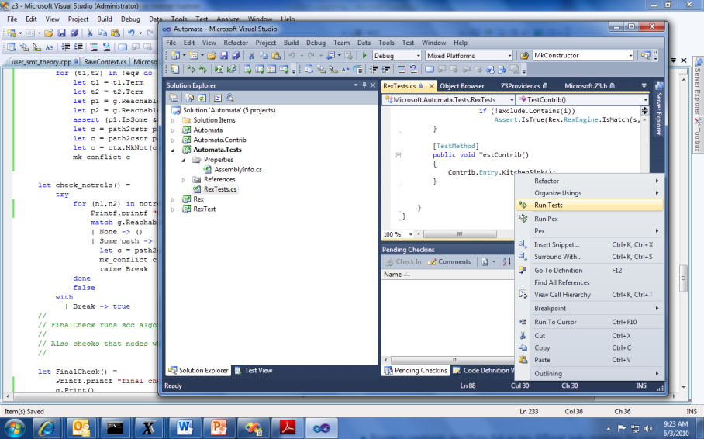


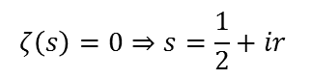
SMT by Example: Job Shop Scheduling
Machines
Tasks
Jobs
P = NP?
Laundry
$$ζ\left(s\right)=0⇒s=\frac{1}{2}+ir$$

Slide 18
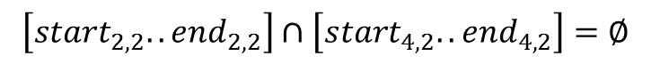
Job Shop Scheduling
Constraints:
Precedence: between two tasks of the same job
Resource: Machines execute at most one job at a time
3
1
2
4
$$\left[start_{2,2}..end_{2,2}\right]∩\left[start_{4,2}..end_{4,2}\right]=∅$$

Slide 19
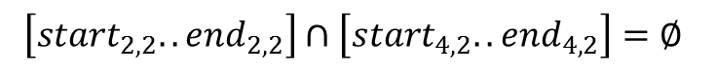
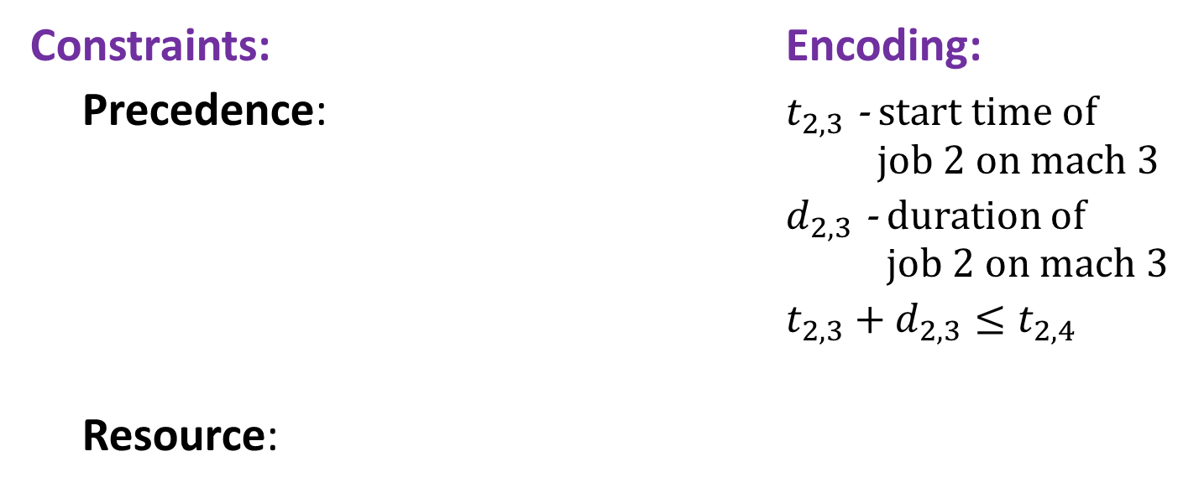
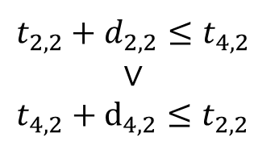
Job Shop Scheduling
Constraints: Encoding:
Precedence: $t_{2,3}$ - start time of job 2 on mach 3
$d_{2,3}$ - duration of job 2 on mach 3
$t_{2,3}+d_{2,3}≤t_{2,4}$
Resource:
3
1
4
2
Not convex
$$t_{2,2}+d_{2,2}≤t_{4,2}$$
$$∨$$
$$t_{4,2}+d_{4,2}≤t_{2,2}$$
$$\left[start_{2,2}..end_{2,2}\right]∩\left[start_{4,2}..end_{4,2}\right]=∅$$

Slide 20
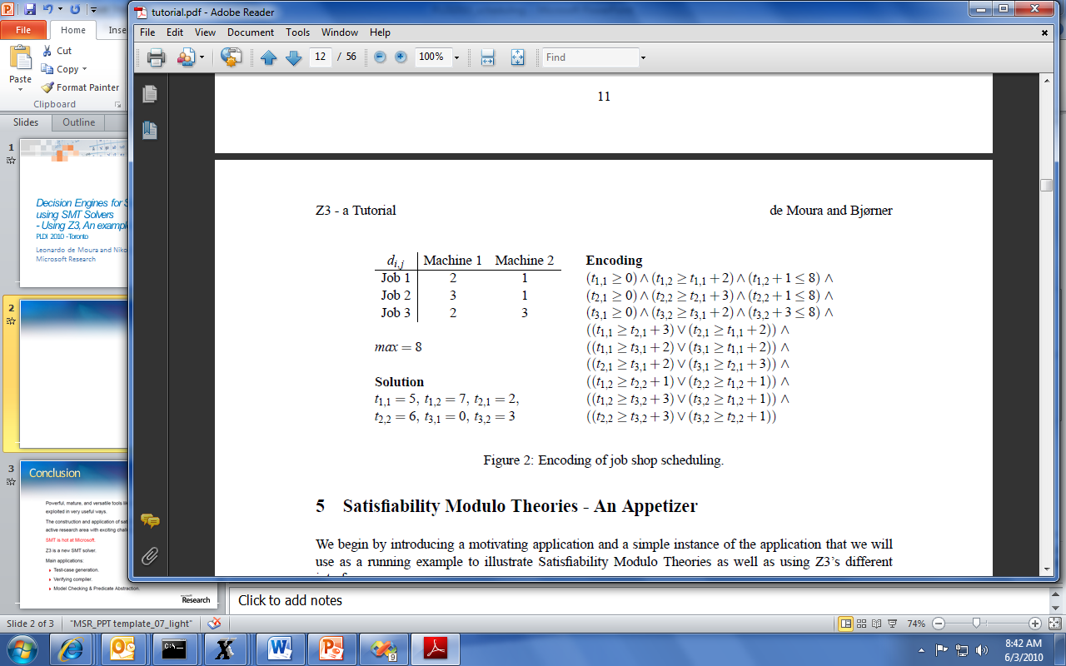
Job Shop Scheduling

Slide 21
Job Shop in SMT-LIB2
SMT-LIB2 is a format for exchanging benchmarks between SMT solvers.
It is also convenient for text-based interaction.
Z3 supports SMT-LIB2 + additional goodies

Slide 22
Job Shop in SMT2
Start Z3 using smt-lib mode in interactive (/si) enable models (/m).
Z3.exe /smt2 /is /m
Optionally specify the logic. The benchmark is going to use Integer Difference Logic and use the a solver for difference logic
(set-logic QF_IDL)
(declare-fun t11 () Int)
(declare-fun t12 () Int)
(declare-fun t21 () Int)
(declare-fun t22 () Int)
(declare-fun t31 () Int)
(declare-const t32 Int)
Declare constants that are going to be used in the problem.
Constants are functions that don’t take any arguments.
Z3 shorthand for declare-fun … () ..

Slide 23
Job Shop in SMT2
Add the precedence constraints
(assert (and (>= t11 0) (>= t12 (+ t11 2)) (<= (+ t12 1) 8)))
(assert (and (>= t21 0) (>= t22 (+ t21 3)) (<= (+ t22 1) 8)))
(assert (and (>= t31 0) (>= t32 (+ t31 2)) (<= (+ t32 3) 8)))

Slide 24
Job Shop in SMT2
Add the resource constraints
(assert (or (>= t11 (+ t21 3)) (>= t21 (+ t11 2))))
(assert (or (>= t11 (+ t31 2)) (>= t31 (+ t11 2))))
(assert (or (>= t21 (+ t31 2)) (>= t31 (+ t21 3))))
(assert (or (>= t12 (+ t22 1)) (>= t22 (+ t12 1))))
(assert (or (>= t12 (+ t32 3)) (>= t32 (+ t12 1))))
(assert (or (>= t22 (+ t32 3)) (>= t32 (+ t22 1))))

Slide 25
Job Shop in SMT2
(check-sat)
(model)
Check satisfiability of the assertions
Display the model
("model" "t11 -> 5
t12 -> 7
t21 -> 2
t22 -> 5
t31 -> 0
t32 -> 2")

Slide 26
SMT2 Brief Sketch
(declare-fun id (sort*) sort) declare function
(define-fun id ((id sort)*) sort term)
define an expression shorthand
(assert term) assert formula
(check-sat) check satisfiability of assertions
(push [number]) push 1 (or number) scopes
(pop [number]) pop 1 (or number) scopes
(get-info model) model from satisfied assertions

Slide 27
SMT2 Brief Sketch
term ::= id
| number
| (id term+)
| (forall (id sort)+ term)
sort ::= id | (id sort+)
id ::= and | or | => | + | - | * | …| token | …

Slide 28
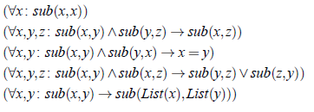
Quantifiers
Example: Single inheritance subtyping
(declare-sort Type)
(declare-fun subtype (Type Type) Bool)
(delcare-fun List (Type) Type)
(assert (forall (x Type) (subtype x x)))
(assert (forall (x Type) (y Type) (z type)
(=> (and (subtype x y) (subtype y z))
(subtype x z))))
(assert (forall (x Type) (y Type)
(=> (and (subtype x y) (subtype y x))
(= x y))))
(assert (forall (x Type) (y Type) (z type)
(=> (and (subtype x y) (subtype x z))
(or (subtype y z) (subtype z y)))))
(assert (forall (x Type) (y Type)
(=> (subtype x y)
(subtype (List x) (List y)))))

Slide 29
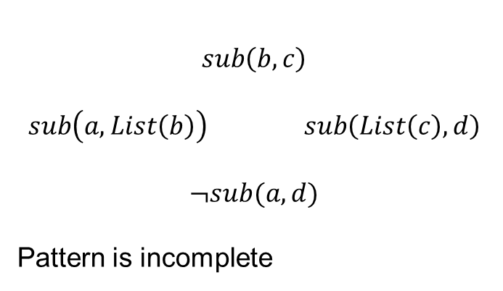
Quantifiers
Example: Single inheritance subtyping
(assert (forall (x Type) (y Type)
(=> (subtype x y)
(subtype (List x) (List y)))
:pat {(subtype (List x) (List y)) }
)
)
$$sub\left(b,c\right)$$
$$sub\left(a,List\left(b\right)\right) sub\left(List\left(c\right),d\right)$$
$$¬sub(a,d)$$
Pattern is incomplete

Slide 30
Quantifiers
Example: Single inheritance subtyping
(assert (forall (x Type) (y Type)
(=> (subtype x y)
(subtype (List x) (List y)))
:pat {(subtype x y) }
)
)
(=> (subtype a b) (subtype (List a) (List b)))
(=> (subtype (List a) (List b)) (subtype (List (List a)) (List (List b))) )
… matching loop

Slide 31
Quantifiers
Example: Single inheritance subtyping
(assert (forall (x Type) (y Type)
(=> (subtype x y)
(subtype (List x) (List y)))
:pat {(List x) (List y) }
)
)
Multi-pattern
☺ Terminates:
depth of new terms is bounded
☹ Expensive:
Quadratic
Instantiated for every pair of (List a) and (List b) created during search
.. But transitive closure is worse – it is cubic.

Slide 32
Decidability and Decision Procedures

Slide 33
Satisfiability Modulo Theories (SMT)
Is formulaϕ satisfiable modulo theory T ?
SMT solvers have specialized algorithms for T

Slide 34
Little Engines of Proof
An SMT Solver is a collection of
Little Engines of Proof

Slide 35
Little Engines of Proof
An SMT Solver is a collection of
Little Engines of Proof
Examples:
SAT Solver
Equality solver
Arithmetic, Array, Bit-vector, data-type solvers

Slide 36
User-interaction and Guidance

Slide 37
Interacting with Z3
Text
Programmatic API
LINQ,

Slide 38
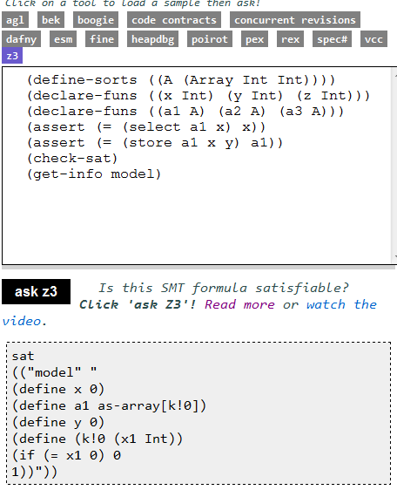
Solver outputs
Logical Formula
Sat/Model

Slide 39
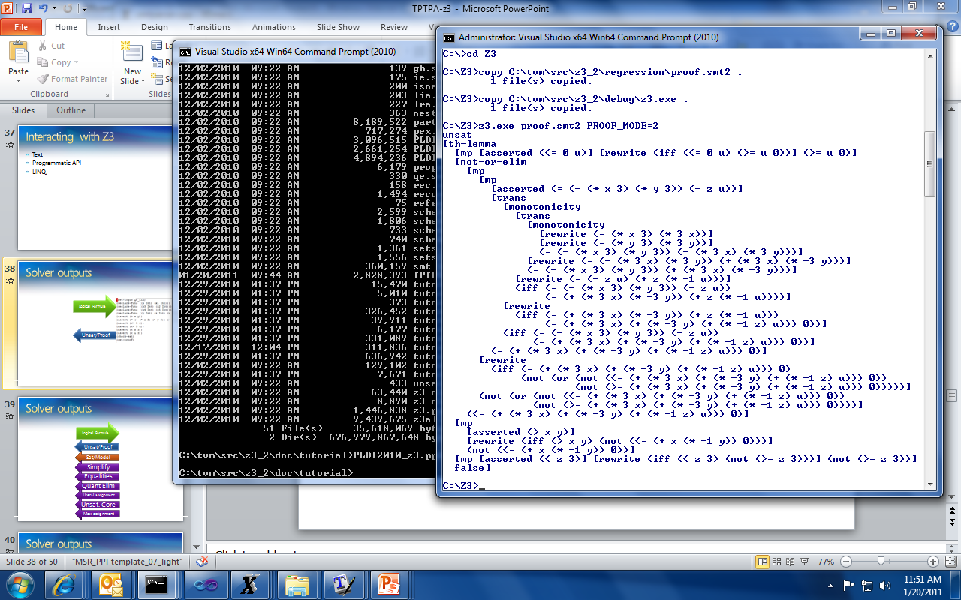
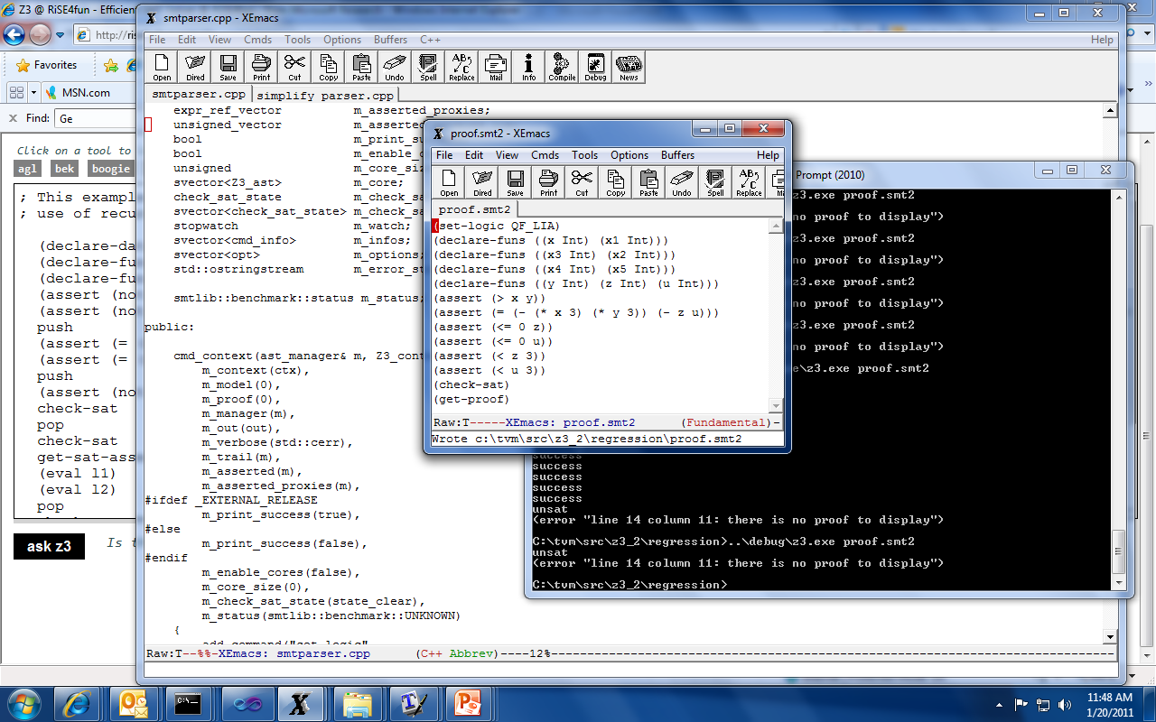
Solver outputs
Logical Formula
Unsat/Proof

Slide 40
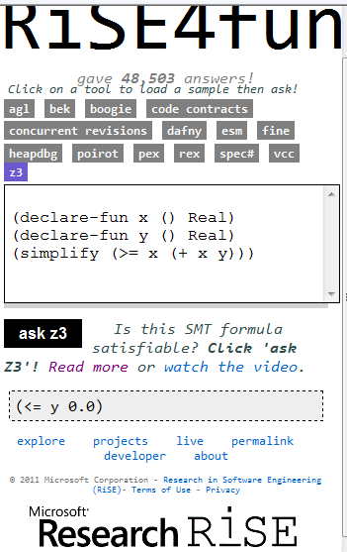
Solver outputs
Logical Formula
Simplify

Slide 41
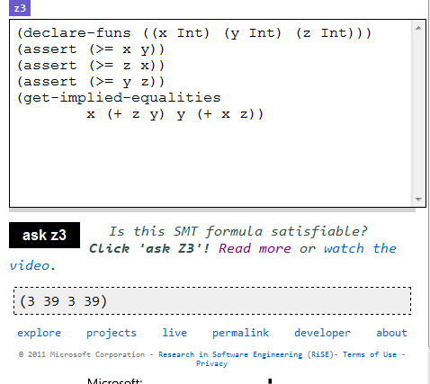
Solver outputs
Logical Formula
x and y are equal
z + y and x + z are equal
Implied
Equalities

Slide 42
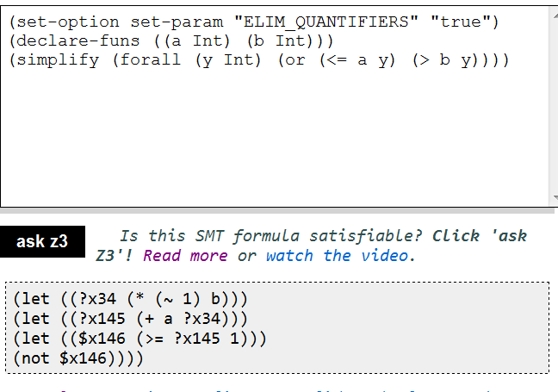
Solver outputs
Logical Formula
Quantifier
Elimination

Slide 43
Solver outputs
Logical Formula
Literal assignment
Unsat. Core
Max assignment

Slide 44
Solver outputs
Logical Formula
Unsat/Proof
Sat/Model
Simplify
Equalities
Quant Elim
Literal assignment
Unsat. Core
Max assignment

Slide 45
Main applications

Slide 46
Main Applications
Test case generation
Verifying Compilers
Predicate Abstraction
Invariant Generation
Type Checking
Model Based Testing

Slide 47



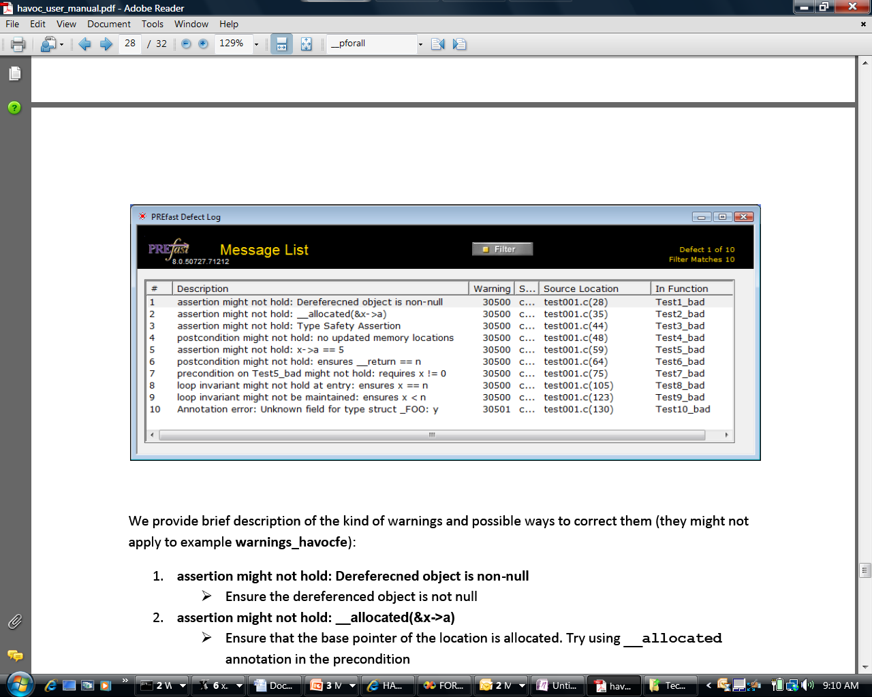
Some Microsoft Engines using Z3
SDV: The Static Driver Verifier
PREfix: The Static Analysis Engine for C/C++.
Pex: Program EXploration for .NET.
SAGE: Scalable Automated Guided Execution
Spec#: C# + contracts
VCC: Verifying C Compiler for the Viridian Hyper-Visor
HAVOC: Heap-Aware Verification of C-code.
SpecExplorer: Model-based testing of protocol specs.
Yogi: Dynamic symbolic execution + abstraction.
FORMULA: Model-based Design
F7: Refinement types for security protocols
Rex: Regular Expressions and formal languages
VS3: Abstract interpretation and Synthesis
VERVE: Verified operating system
FINE: Proof carrying certified code

Slide 48
Test case generation
unsigned GCD(x, y) {
requires(y > 0);
while (true) {
unsigned m = x % y;
if (m == 0) return y;
x = y;
y = m;
}
}
(y₀ > 0) and
(m₀ = x₀ % y₀) and
not (m₀ = 0) and
(x₁ = y₀) and
(y₁ = m₀) and
(m₁ = x₁ % y₁) and
(m₁ = 0)
x₀ = 2
y₀ = 4
m₀ = 2
x₁ = 4
y₁ = 2
m₁ = 0
SSA
Solver
We want a trace where the loop is executed twice.

Slide 49
PEX ↔ Z3
Rich Combination
Linear Arithmetic
Bitvectors
Arrays
Models
∀-Quantifier
API
Huge number of small problems. Textual interface is too inefficient.
Used to model custom theories (e.g., .NET type system)
Model used as test inputs
Free
Functions

Slide 50
Type checking
Signature:
div : int, { x : int | x ≠ 0 } → int
Subtype
Call site:
if a ≤ 1 and a ≤ b then
return div(a, b)
Verification condition
a ≤ 1 and a ≤ b implies b ≠ 0

Slide 51
Summary

Slide 52
When to use SMT solvers
To discharge basic theorems automatically
Larger search problems:
Integration with SAT solver cores enable modern, efficient search algorithms.
When your problem uses common theories: Arithmetic, Arrays, Data-types, bit-vectors.
Mostly ground, but with some support for quantifiers:
Quantifier methods by instantiation Sufficient for program verification problems

